Slide 1
MEDASSIST AI:
AI Medical Symptom Analysis & Disease Prediction System
Milestone 1 Progress
Name: Amrutha M
Branch: CSE - AIML
Internship: Infosys Virtual Internship 7.0

Slide 2
Objective:
To develop a healthcare web application for:
Patient & Healthcare Provider registration
Secure login
Patient & Healthcare Provider dashboard
Symptom collection
Medical history management
Report upload
Technologies Used:
Frontend: React.js
Backend: FastAPI (Python)
Database: SQLite
Libraries: Pandas, Scikit-learn, NumPy

Slide 3
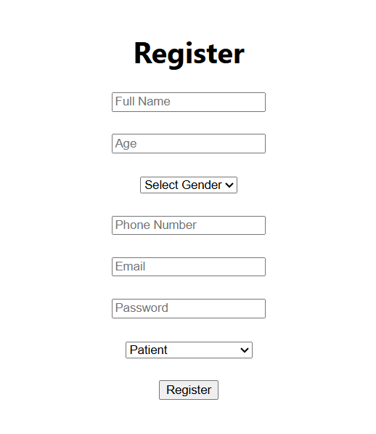
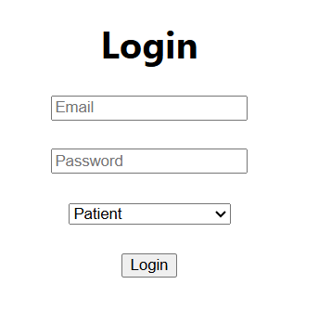
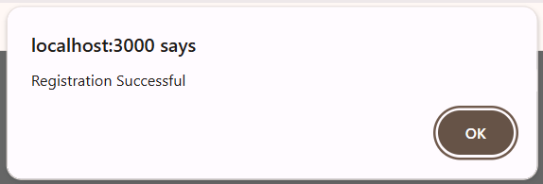
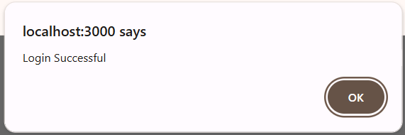
Registration & Login Module

Slide 4
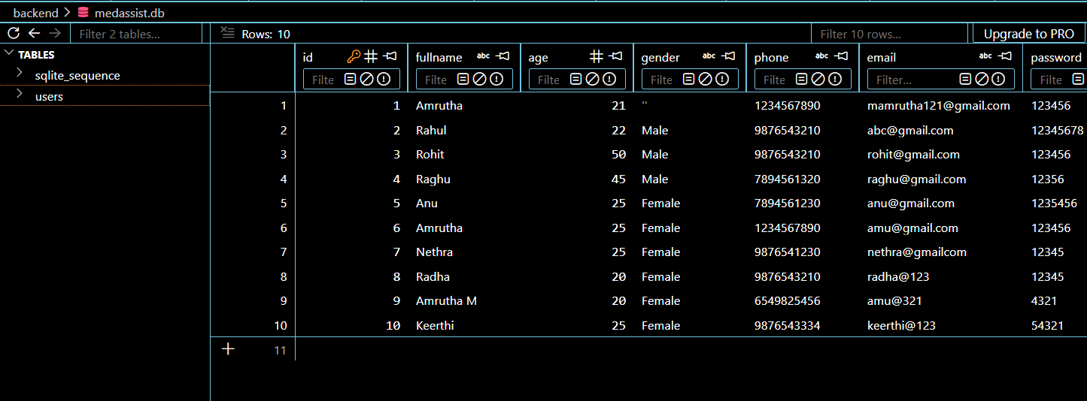
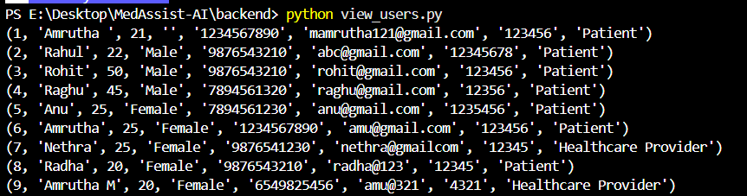
The registered data stored in the dataset
This screenshot shows how user data is stored in the medassist database after registration
This is the output of running the Python script:

Slide 5
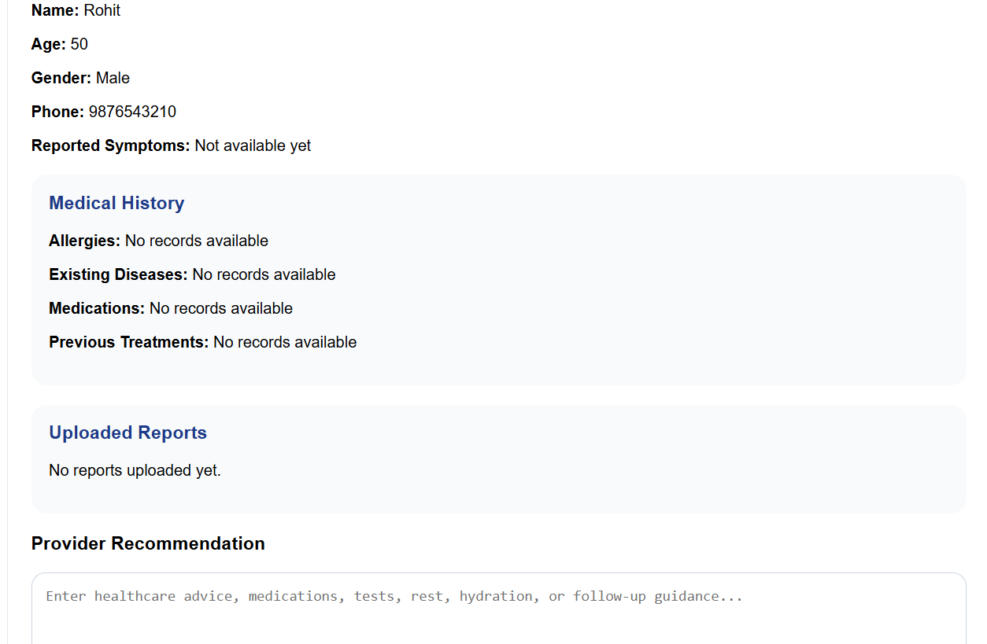
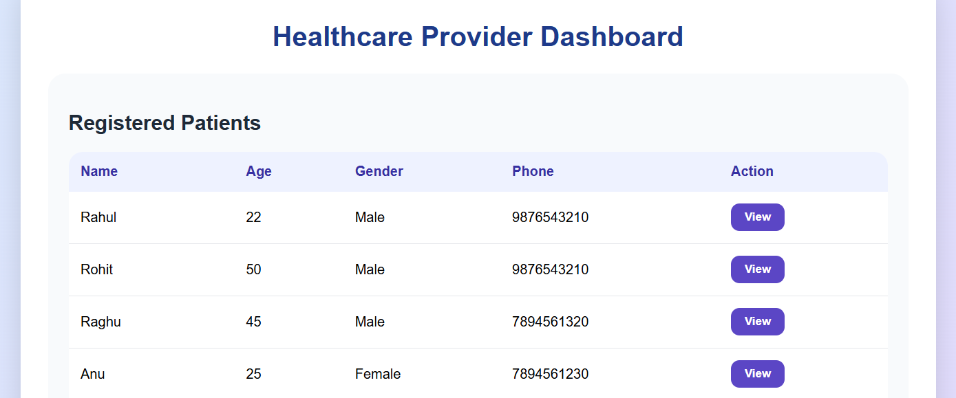

Slide 6
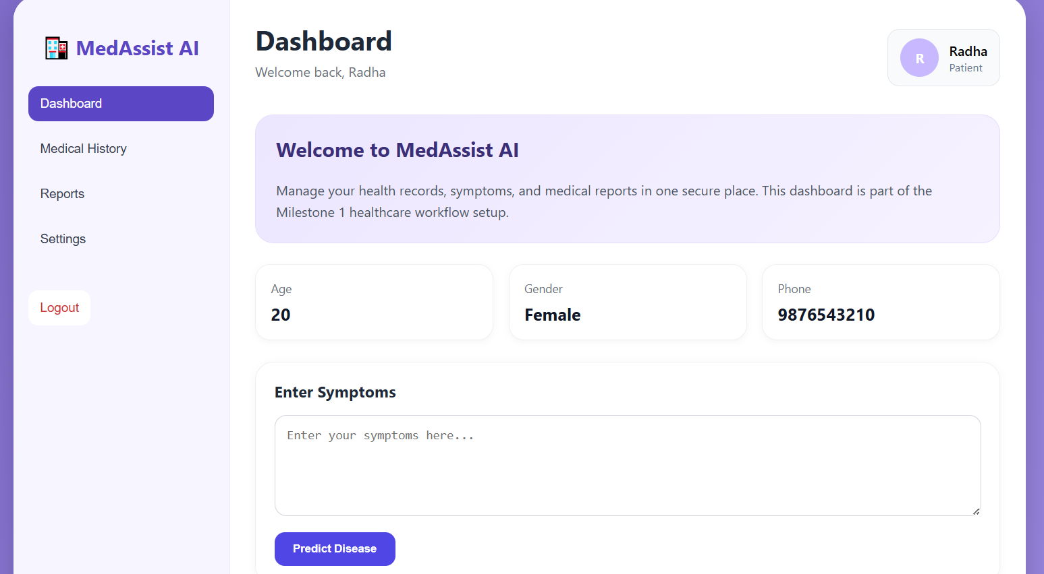
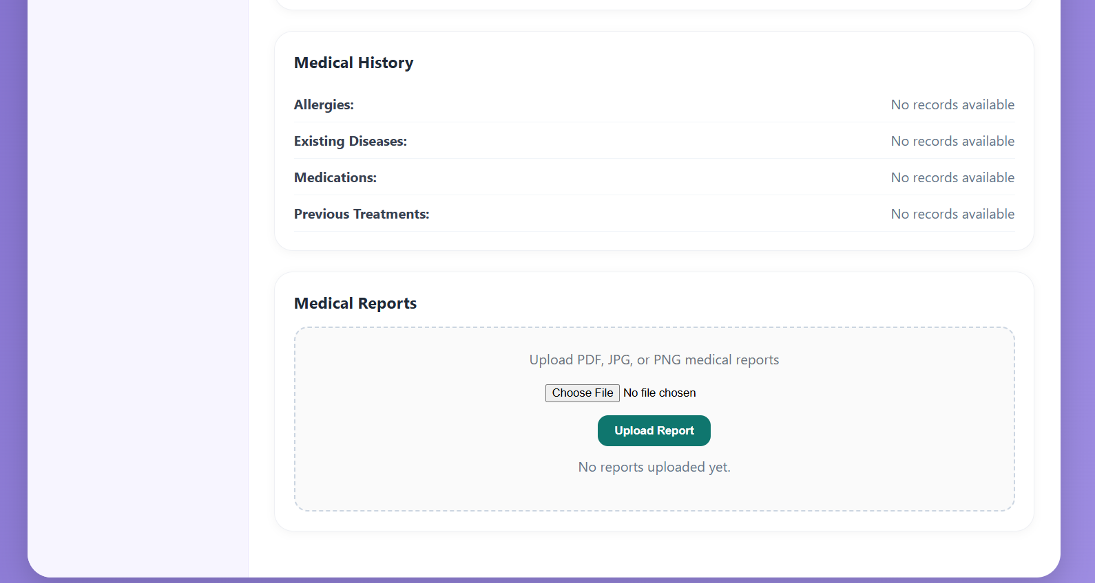

Slide 7
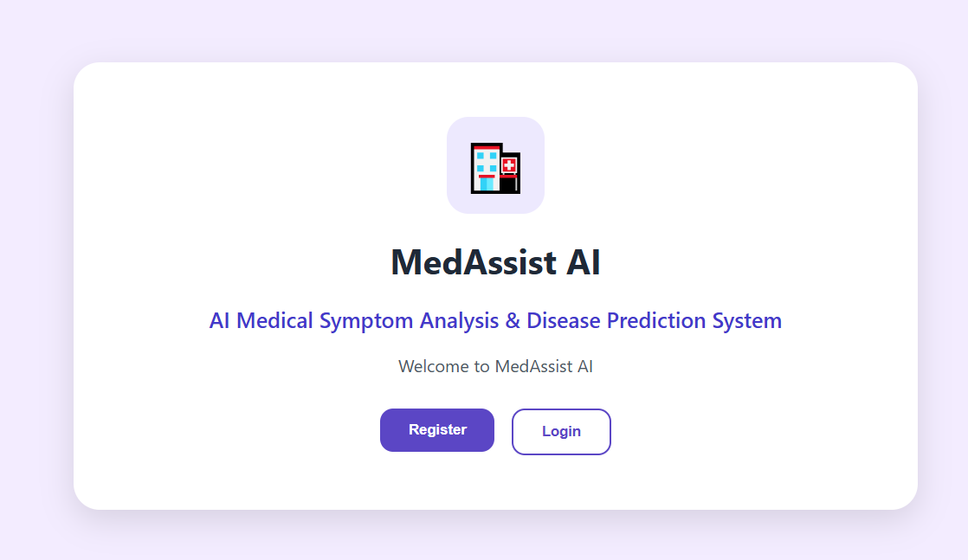
home page

Slide 8
Thankyou

